Slide 1
An Expert System for Depression Diagnosis
Izzeddin A. Alshawwa, Mohammed Elkahlout, Hosni Qasim El-Mashharawi, Samy S. Abu-Naser
Review
DLarisa
Security & Applied Logic - 510

Slide 2
Table of Contents
01
02
03
04
Paper Summary
Method
Strenghts
Weaknesses

Slide 3
01
Paper Summary

Slide 4
Paper Summary
The paper was written by members of the Faculty of Engineering & IT from the University of Palestine.
The authors of the paper proposed an expert system for diagnosing depression. This approach was implemented using SL5 Object Language and it is based on a forward chaining reasoning method that can make inferences about facts of the world using rules and objects and it is capable of producing appropriate results.
Notes:
Autorii propun un algoritm pentru un sistem expert care să identifice depresia în pacienți. Pentru aceasta folosesc SL5 care poate face inferențe despre fapte ale lumii folosind reguli și obiecte și este capabilă să producă rezultate adecvate.

Slide 5
02
Method
Depression, Expert System, SL5 Object Language, Algorithm

Slide 6
Terms
Depression
Expert System
SL5 Object Language
Depression is a common and serious medical illness that negatively affects how you feel, the way you think and how you act. Depression causes feelings of sadness and/or a loss of interest in activities you once enjoyed. It can lead to a variety of emotional and physical problems and can decrease your ability to function at work and at home.
In artificial intelligence, an expert system is a computer system emulating the decision-making ability of a human expert. Expert systems are designed to solve complex problems by reasoning through bodies of knowledge, represented mainly as if–then rules rather than through conventional procedural code.
SL5 Object is a rule-based language for specifying expert systems. It’s declarative. A SL5 Object program is made up of a set of statements about the world, rather than a list of commands to execute. In fact, since SL5 Object is a rule-based system, these statements about the world are either facts, rules or Objects.
Notes:
Depresia, după cum știm, este o boală psihologică care afectează viața pacienților, deoarece crează sentimente de tristețe, neliniște, izolare etc...
Un sistem expert este un AI care încearcă să ia decizii referitoare la un anumit subiect, într-o manieră similară cu cea a unui expert uman. Sistemele experte sunt concepute pentru a rezolva probleme complexe și sunt construite pe relații de tipul IF-ELSE.
Iar, limbajul SL5 este specific sistemelor expert, fiind declarativ. Un program SL5 este alcătuit dintr-un set de declarații despre lume, mai degrabă decât dintr-o listă de comenzi de executat. De fapt, deoarece SL5 este un sistem bazat pe reguli, aceste afirmații despre lume sunt fie fapte, reguli, sau obiecte.

Slide 7
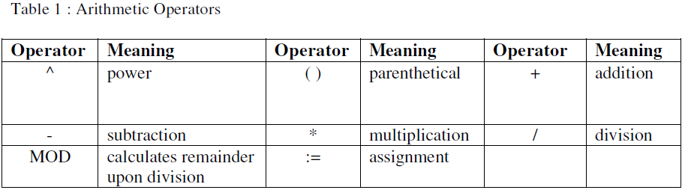
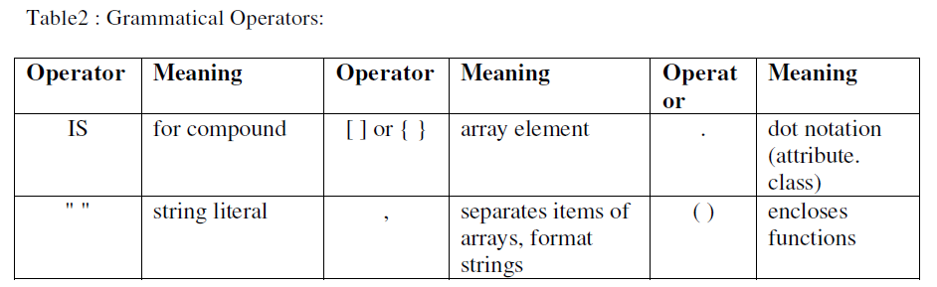
SL5 Language
Notes:
Avem câteva exemple de reguli, operatori și cod pentru limbajul SL5.

Slide 8
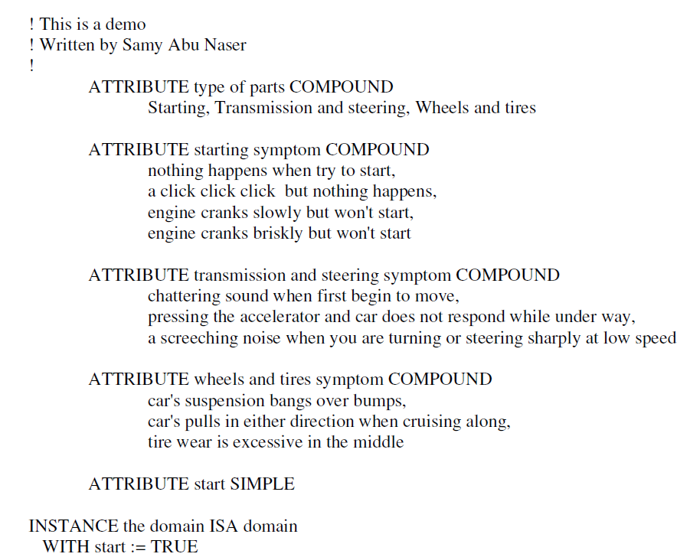
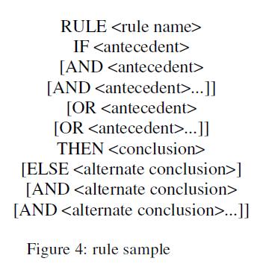
SL5 Language

Slide 9
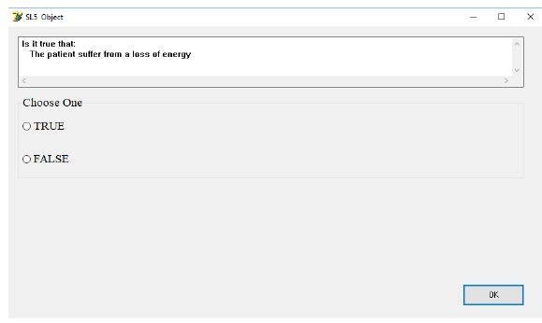
Method
The authors created a free expert system for diagnosing depression using 9 rules: a loss of energy, a change in appetite, sleeping more or less, anxiety, reduced concentration, indecisiveness, restlessness, feelings of worthlessness, guilt or hopelessness and thoughts of self-harm or suicide. The proposed expert system aims to diagnose depression through a series of yes or no questions. Users will be prompted to select the appropriate response on each screen. Following the dialogue session, the algorithm will offer a diagnosis and recommendations for treatment to the user.
Notes:
Autorii au creat sistemul expert bazându-se pe 9 reguli de identificare a depresiei: pierderea energiei, schimbare în apetit, schimbări în programul de somn (a dormi prea mult sau insuficient), anxietate, concentrare redusă, indecisivitate, neliniște, nehotărâre, sentimente de inutilitate, vinovăție sau lipsă de speranță și gânduri de auto-vătămare sau sinucidere.
Sistemul expert se bazează pe întrebări cu răspunsul DA sau NU. Utilizatorilor li se va solicita să selecteze răspunsul corespunzător pe fiecare ecran. În urma sesiunii de dialog, algoritmul va oferi utilizatorului un diagnostic și recomandări de tratament.

Slide 10
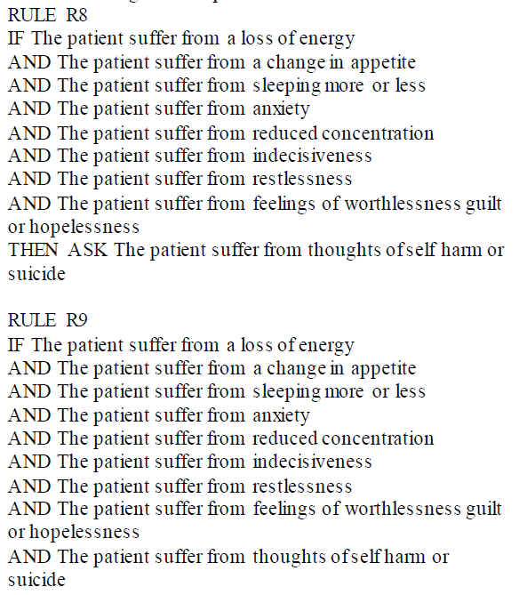
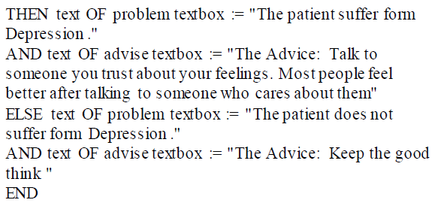
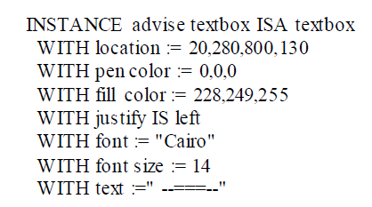
Source Code Sample
Notes:
După cum putem remarca este un fel de algoritm IF-ELSE, după cum spuneam și anterior.

Slide 11
03
Summary of Strenghts

Slide 12
Strenghts
SL5 for diagnosing depression has not been implemented before, so it represents a novel perspective. The algorithm was also provided for free.
It has user-friendly interface, doesn't require intensive training to be used, and takes symptoms as input using YES or NO questions. It is also capable of offering recommendation to the user based on the result of the „consultation”. The algorithm was developted with the help of the Psychology department and was also evaluated by psychology students, who were satisfied with its performance, efficiency, front-end design, and accessibility.
Unlike other expert systems that are specialized in one symptom, the one from this paper has 9.
Notes:
Din cautările mele, aceasta a fost prima lucrare care s-a gândit să încerce să identifice depresia folosind un sistem expert cu ajutorul limbajului SL5. Un alt beneficiu important este faptul că algoritmul a fost oferit pe gratis, în cadrul articolului.
Are o interfață ușor de utilizat, nu necesită pregătire intensivă pentru a fi utilizat și ia simptomele ca input folosind întrebări DA sau NU. De asemenea, sistemul e capabil de a oferi recomandări la finalul „consultației”. Și, în plus, algoritmul a fost dezvoltat cu ajutorul departamentului de Psihologie și a fost evaluat și de studenții la psihologie, care au fost mulțumiți de performanța, eficiența, designul front-end și accesibilitatea acestuia.
Spre deosebire de alte sisteme expert care sunt specializate să identifice doar un singur simptom, cel din articol acceptă 9.

Slide 13
04
Summary of Weaknesses

Slide 14
The paper has multiple mistakes (grammatical, lexical, spelling, etc...). It also has 2 chapters with the same name.
The authors examined papers concerning different affections of the human body, none of which relate to mental illnesses or depression. Additionally, the paper does not mention or review other techniques for diagnosing depression and there is no comparison between their efficiency and the proposed expert system.
The proposed method focuses only on 9 symptoms and relies on direct YES or NO questions. Patients with depression often conceal their emotions and may not respond truthfully, rendering this approach simplistic from a psychological perspective.

Slide 15
The code appears to suggest that the patient has depression only if he/she has all the 9 symptoms, but this is not entirely accurate. Using the OR operator instead of AND would have been more appropriate. Additionally, although the expert system was rated favourably by psychology students, there is a lack of tests performed on patients so we cannot be sure of its accuracy.
Furthermore, I believe that the paper would benefit from including basic information about expert systems and SL5 Object Language in the introduction, for a more comprehensive reading experience. It would have been helpful to include a link to a Github repository as well.

Slide 16
2,5 / 5
Final Grade

Slide 17
Let’s Vote

Slide 18

Thanks
Larisa
Security & Applied Logic, 510
March 2023
Please keep this slide for attribution.

